Slide 1
Case Study 3
Review Sentiment Analysis
By: Enbo Tian, Sirshendu Ganguly, Dang Tran

Slide 2
Motivation and Background
People may make random comments and rating.
People may be influenced by what others say, and go with the tide.

Slide 3
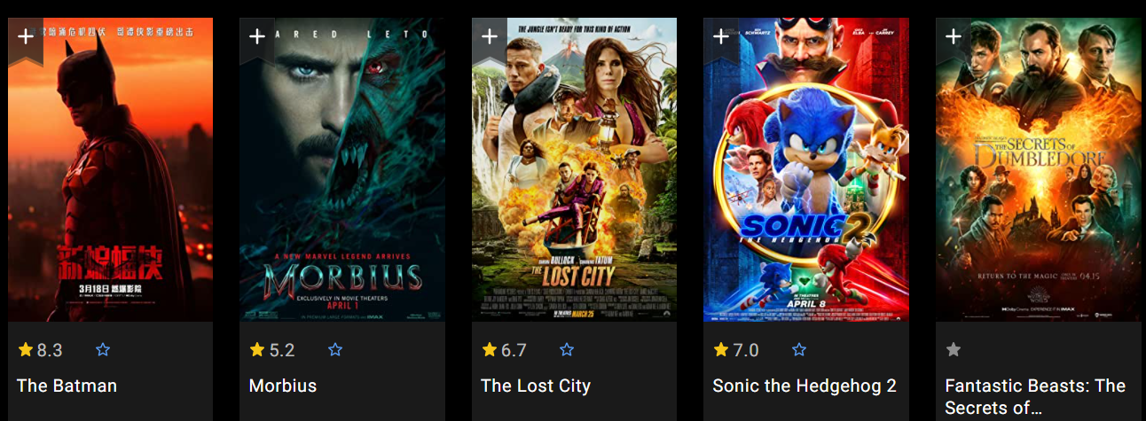
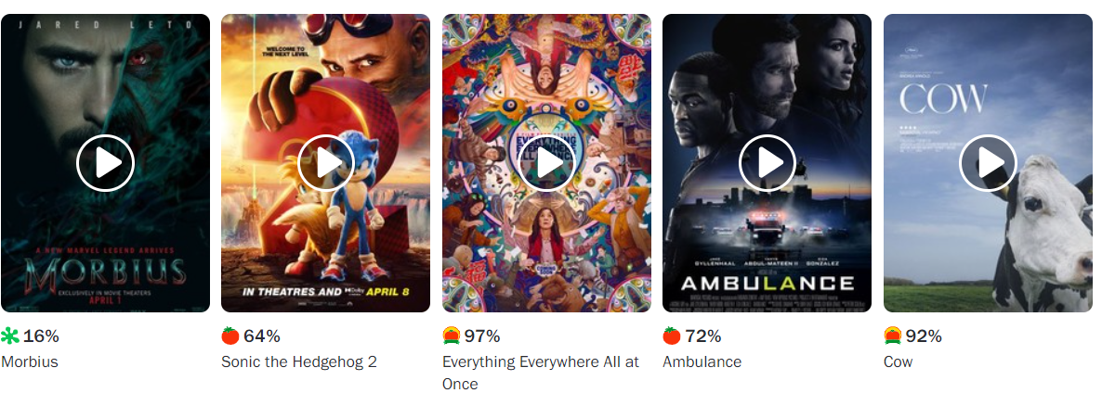
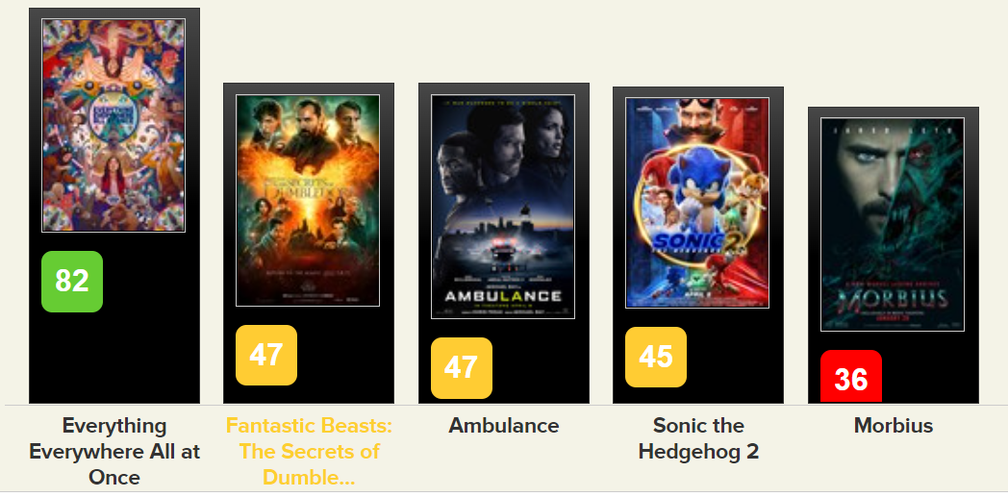
Motivation and Background

Slide 4
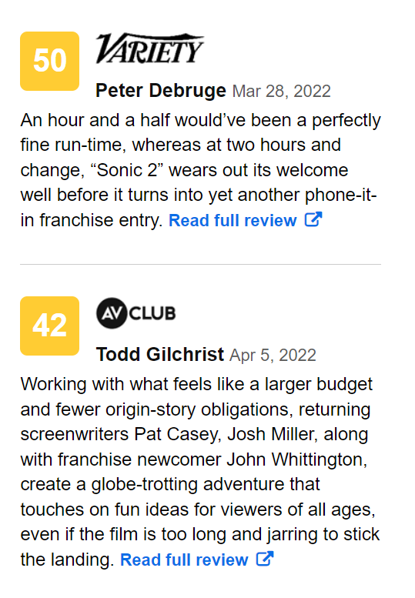
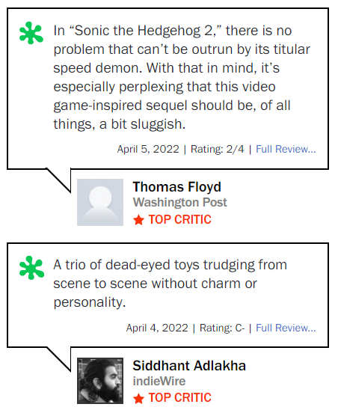
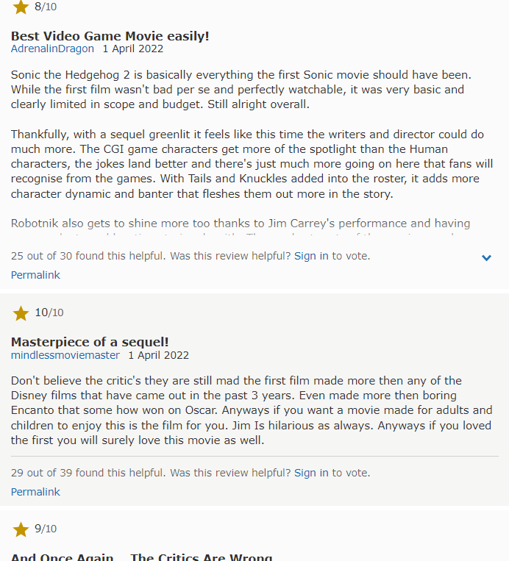
Considering Sonic(Rotten Tomato, IMDb, metacritic)

Slide 5
Data Source

Slide 6
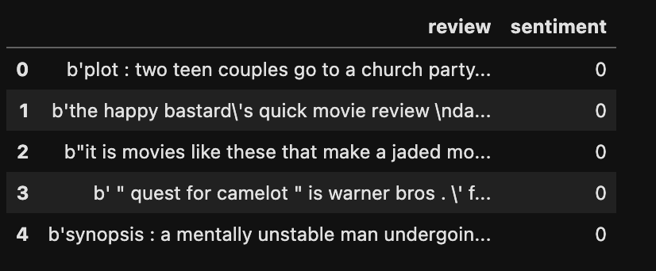
Data Source
review: review received by a movie.
sentiment: sentiment
( 1 for positive, 0 for negative) associated by a movie.
Figure: First 5 rows of the dataframe

Slide 7
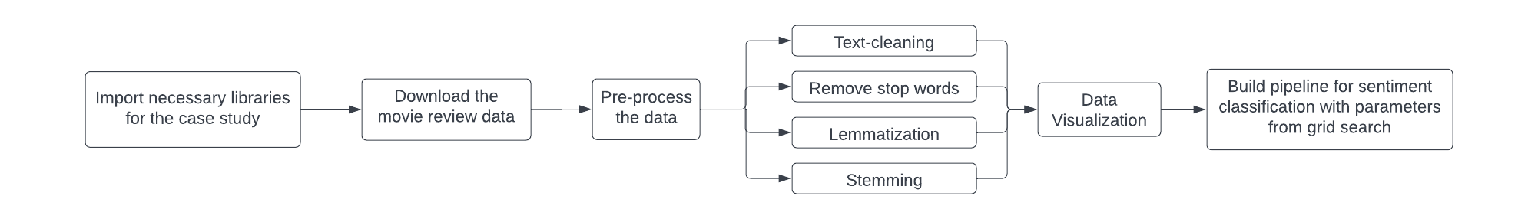
Methodology - Problem 1
Goal: Performing Sentiment Analysis on Movie Reviews
Figure: Workflow for Problem 1
Steps required:
Data pre-processing
Data Exploration
Modelling
Model testing

Slide 8
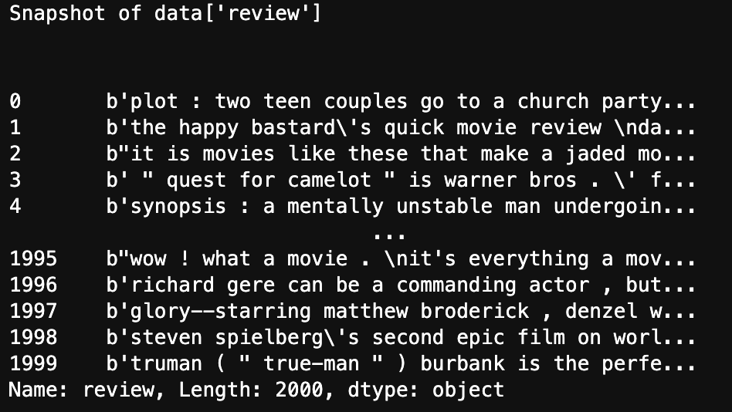
Data pre-processing
Goal: Data pre-processing
Step 1:Only the alphabets are kept from ‘review’ while filtering out everything else and then the alphabets are converted into lowercase.
Step 2: The most common words also known as stop words are removed from ‘review’.
Step 3: Lemmatization is performed on ‘review’.
Step 4: Stemming is performed on ‘review’.
Figure: Snapshot of the data before pre-processing

Slide 9
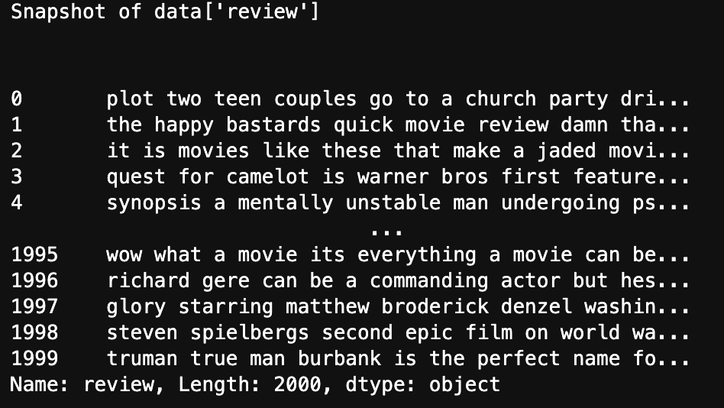
Data Pre-processing: Text-cleaning
Comparison between data[‘review’] before and after text-cleaning
Figure: Snapshot of the data before pre-processing
Figure: Snapshot of the data before after text-cleaning

Slide 10
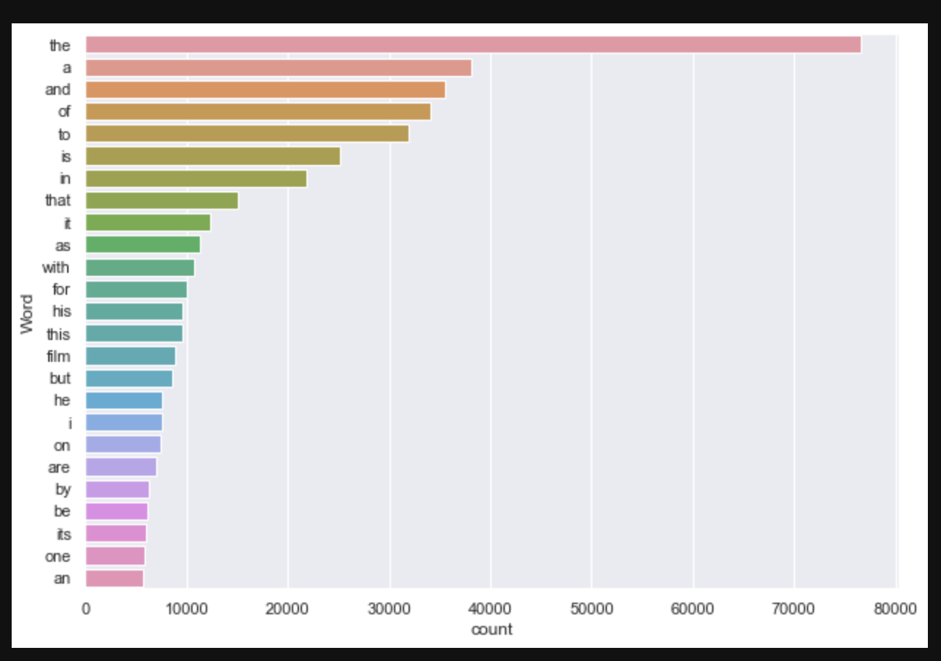
Frequency Distribution of each word in the dataset before pre-processing
We looked into the frequency distribution of each word in the dataset
Key insights:
There are common english words like ‘the’, ’a’ which itself play no role in analysis
The words like ‘he’/’his’ have almost similar meaning.
Figure: Frequency distribution of each word in the dataset after text-cleaning

Slide 11
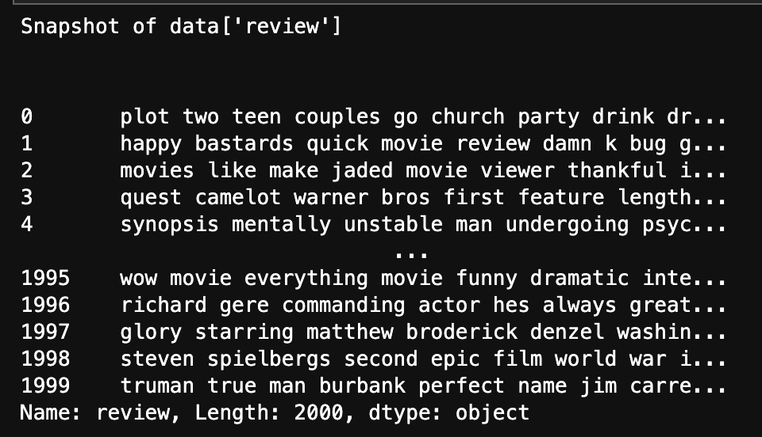
Data Pre-processing: Stop-words removal
Comparison between data[‘review’] before and after stop-words removal
Figure: Snapshot of the data before stop-words removal
Figure: Snapshot of the data after stop-words removal

Slide 12
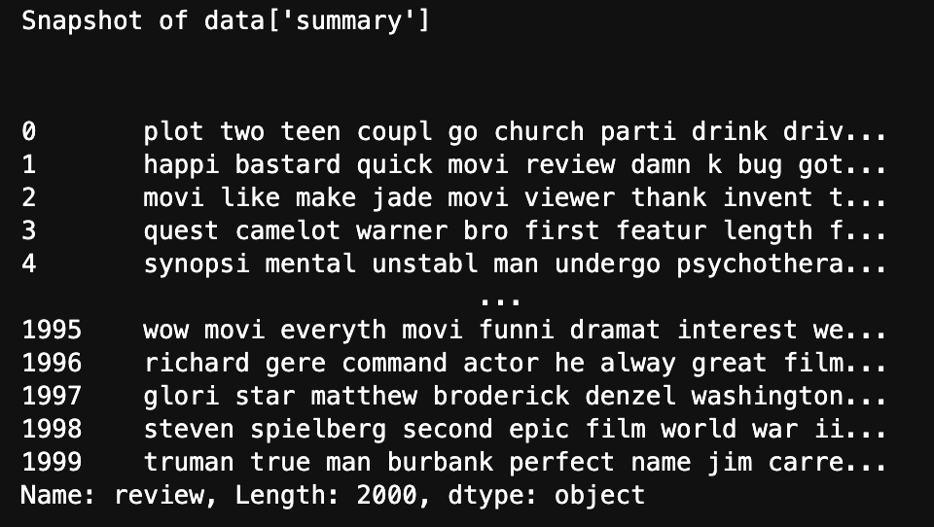
Data Pre-processing: Lemmatization and Stemming
Comparison between data[‘review’] before and after lemmatization and stemming
Figure: Snapshot of the data before lemmatization and stemming
Figure: Snapshot of the data after lemmatization and stemming

Slide 13
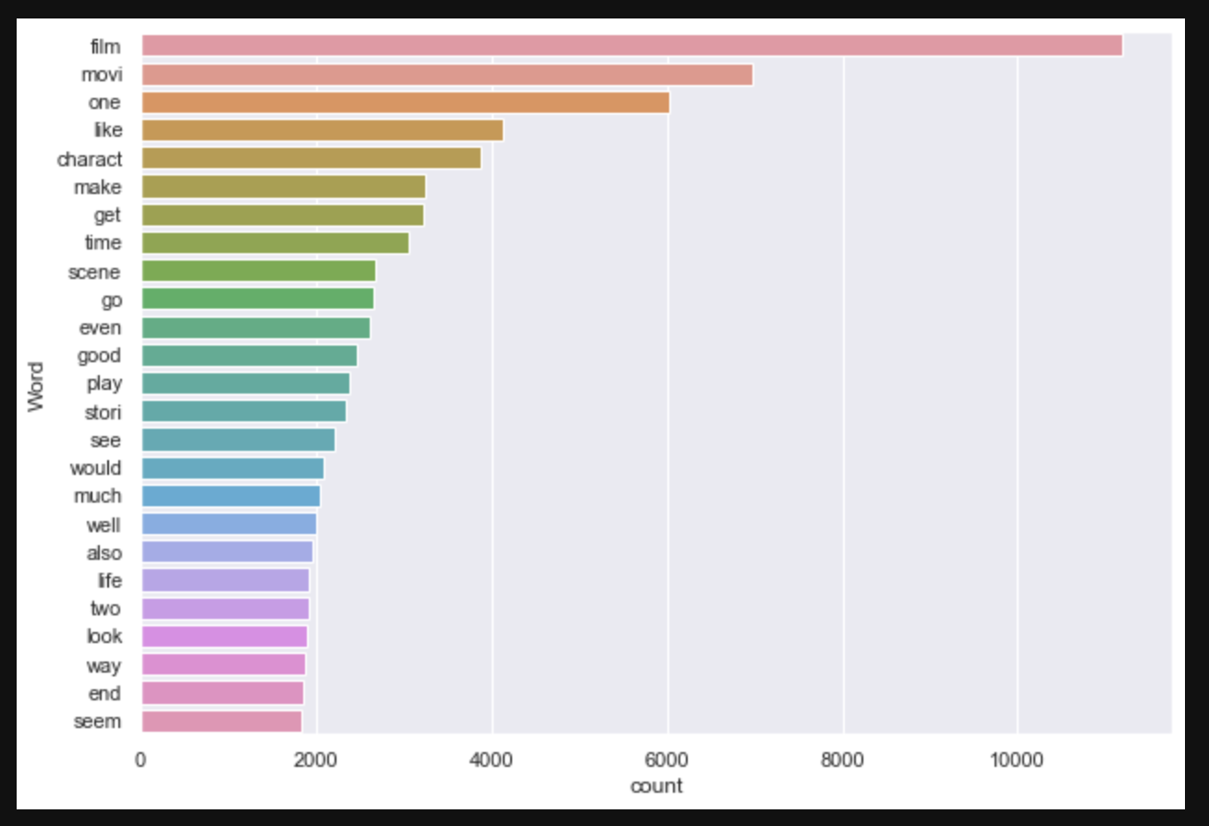
Frequency Distribution of each word in the dataset after pre-processing
We looked into the frequency distribution of each word in the dataset
Key insights:
No more common english words like ‘the’, ’a’.
No more words like ‘he’/’his’ which have almost similar meaning.
Figure: Frequency distribution of each word in the dataset after pre-processing

Slide 14
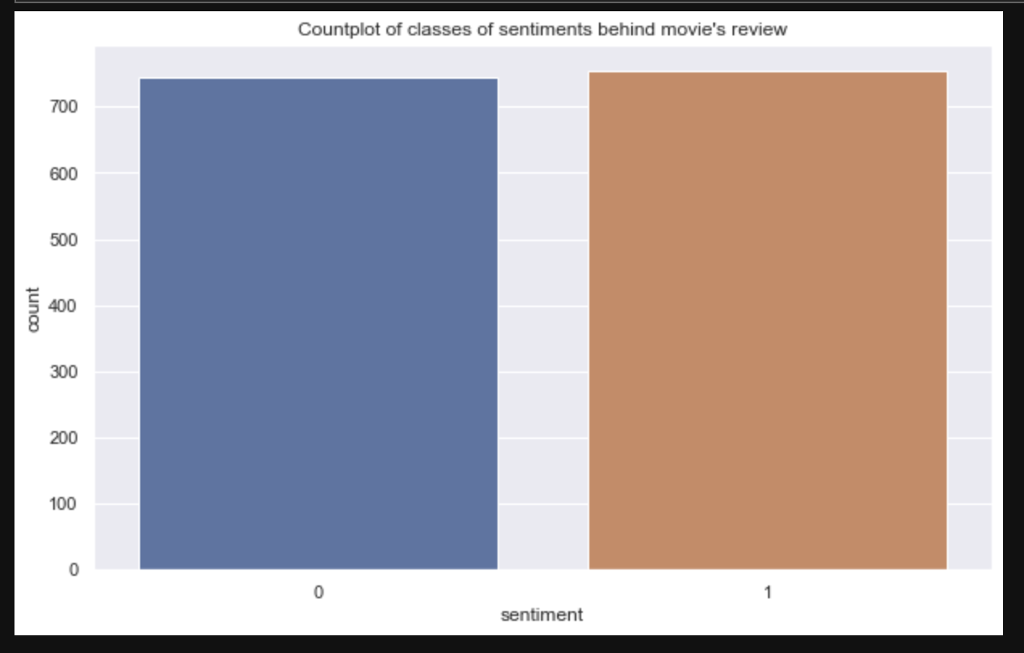
Data exploration:
The bar graph depicting the different types of sentiments in the dataset
Figure: Bar graph of types of sentiments in the dataset

Slide 15
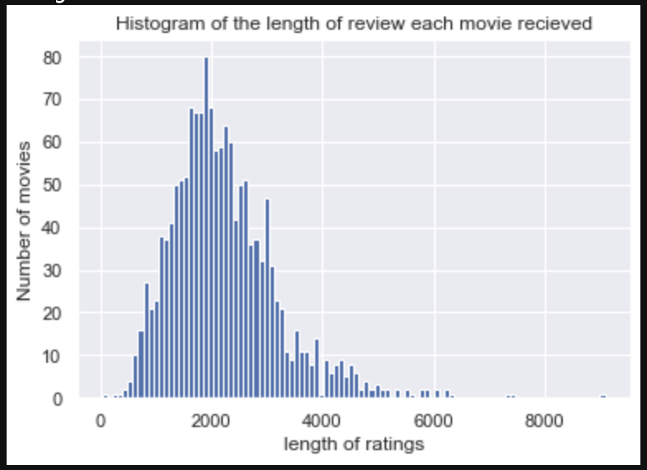
Data exploration:
The histogram depicting the distribution of the length of the movie reviews
Figure: Histogram of the length of the movie reviews

Slide 16
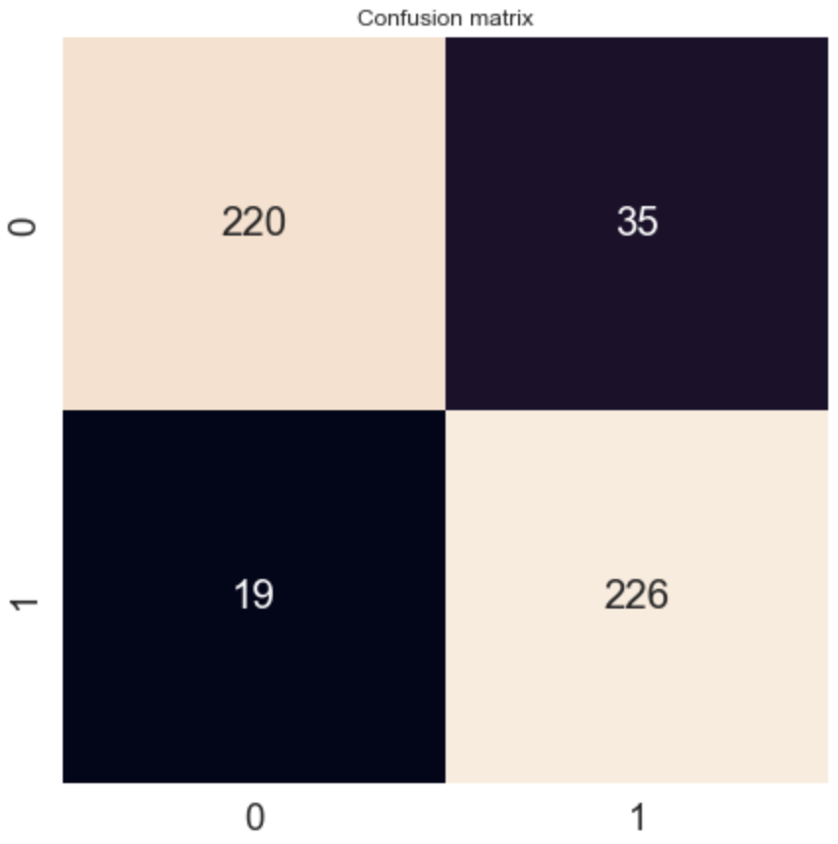
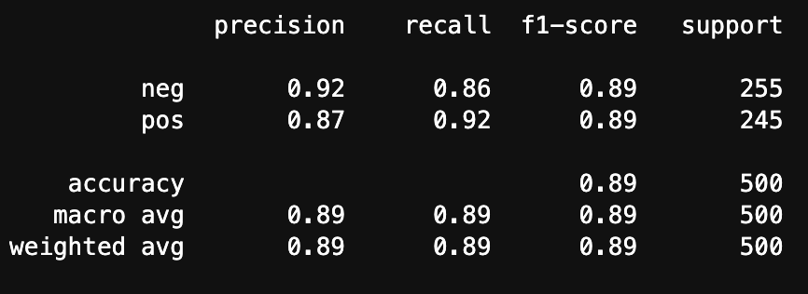
Modelling and Model testing:
We fitted a model using LinearSVC
Figure: Classification report using LinearSVC
Figure: Confusion matrix using LinearSVC

Slide 17
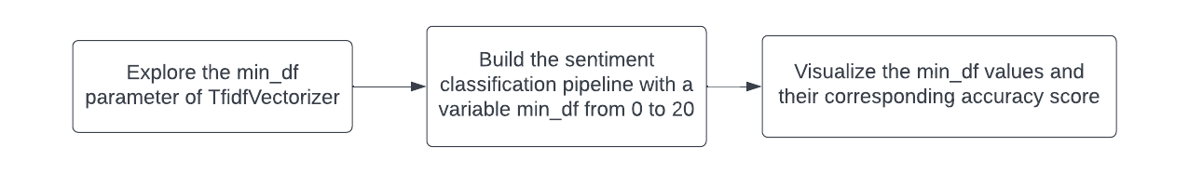
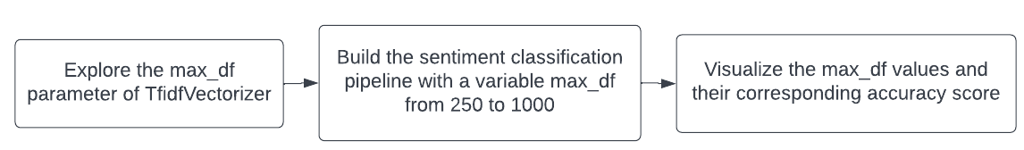
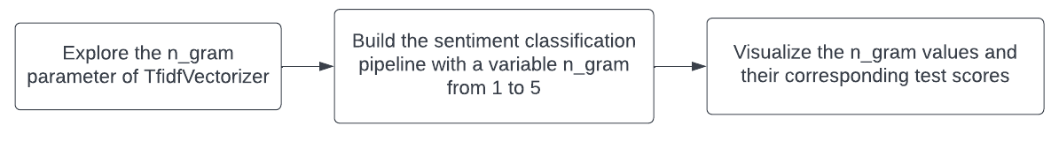
Methodology - Problem 2
Goal: Parameter tuning for TfIdf vectorization
Task in hand:
Exploring relationship between min_df parameter with model accuracy
Exploring relationship between max_df parameter with model accuracy
Exploring relationship between ngram_range parameter with model accuracy
Figure: Workflows for Problem 2

Slide 18
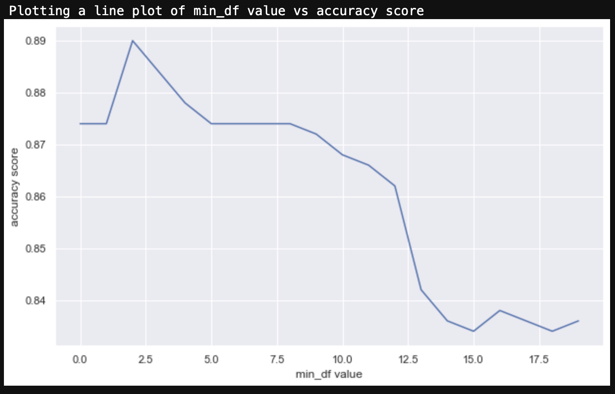
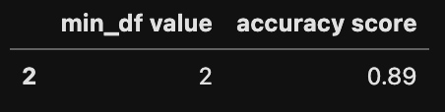
min_df parameter vs model accuracy
The line plot depicting the relationship between min_df and accuracy
Figure: showing the maximum accuracy by a given min_df
Key insights:
Maximum accuracy is given when min_df = 2
Accuracy decreases for any min_df > 2
Figure: Line plot for min_df vs accuracy

Slide 19
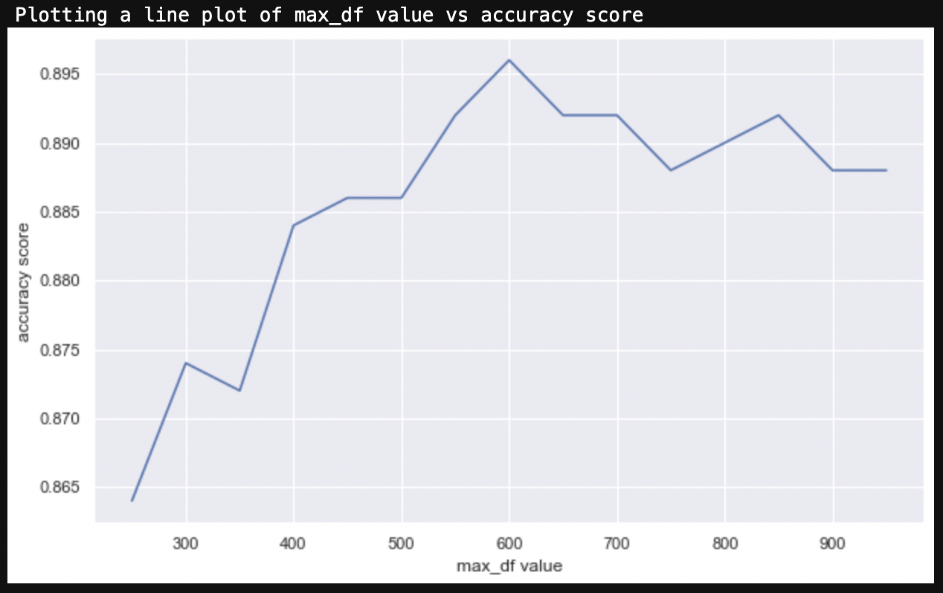
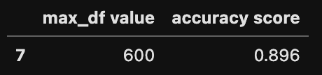
max_df parameter vs model accuracy
The line plot depicting the relationship between max_df and accuracy
Figure: showing the maximum accuracy by a given max_df
Key insights:
Maximum accuracy is given when max_df = 600
Accuracy decreases for any max_df > 600
Figure: Line plot for max_df vs accuracy

Slide 20
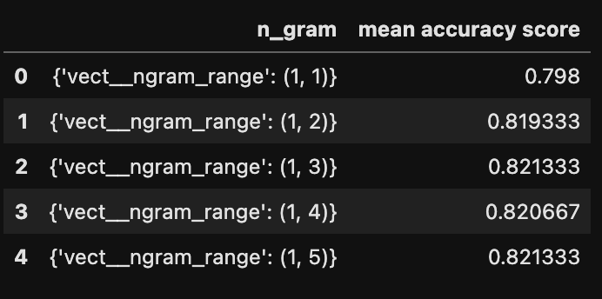
n_gram parameter vs mean model accuracy
Depicting the relationship between n_gram and mean accuracy score
Key insights:
Maximum accuracy is given when
n_gram = (1,3) or (1,5)
Figure: Line plot for max_df vs accuracy

Slide 21
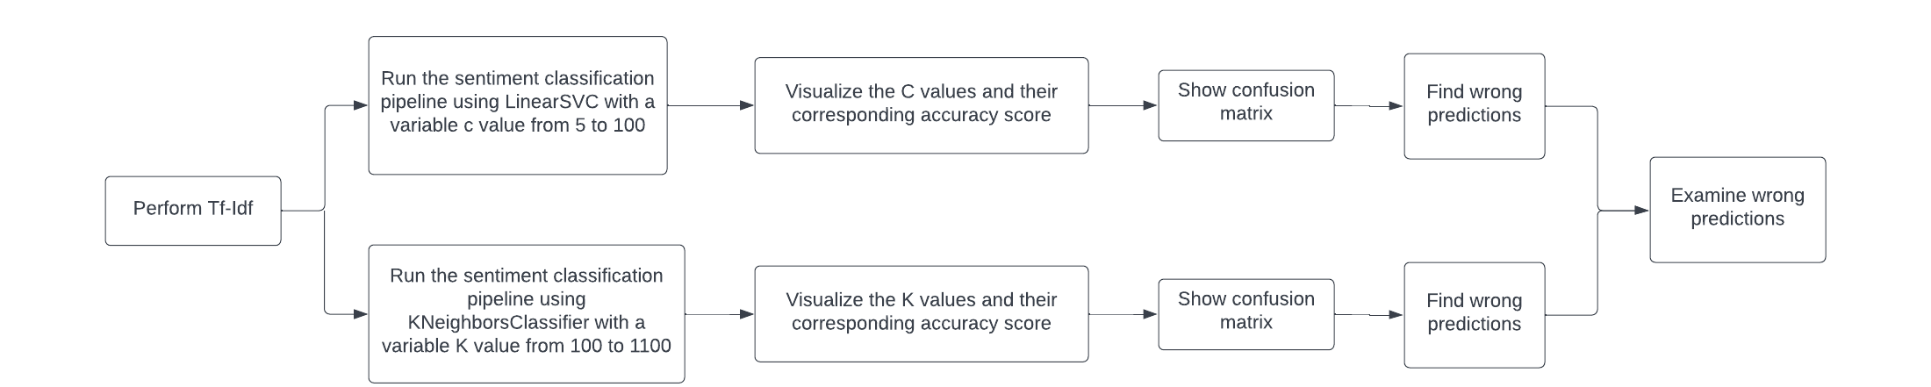
Methodology - Problem 3
Goal: Parameter tuning for sklearn machine learning models and finding out the best classifier
Figure: Workflow for Problem 3
Task in hand:
Exploring relationship between C parameter with model accuracy for LinearSVC
Exploring relationship between k parameter with model accuracy for KNeighborsClassifier
Comparison between LinearSVC and KNeighborsClassifier

Slide 22
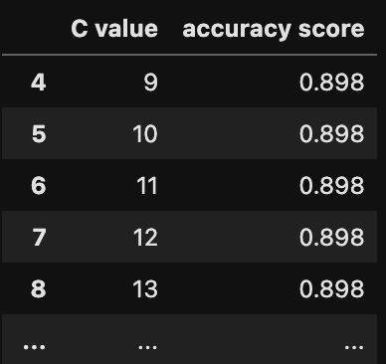
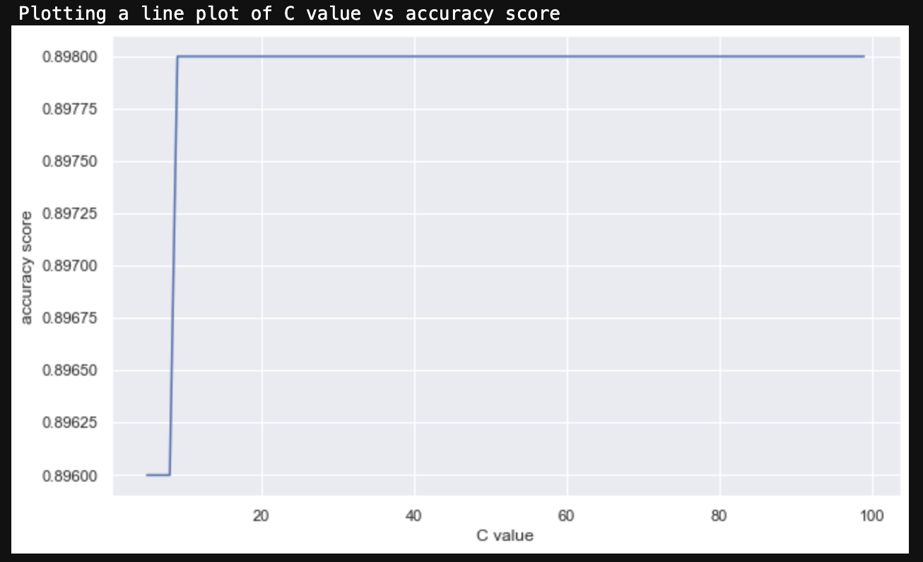
C parameter vs LinearSVC’s model accuracy
The line plot depicting the relationship between C value and accuracy
Figure: showing the maximum accuracy by a given C value
Key insights:
Maximum accuracy is given when C >=9
Figure: Line plot for C value vs accuracy

Slide 23
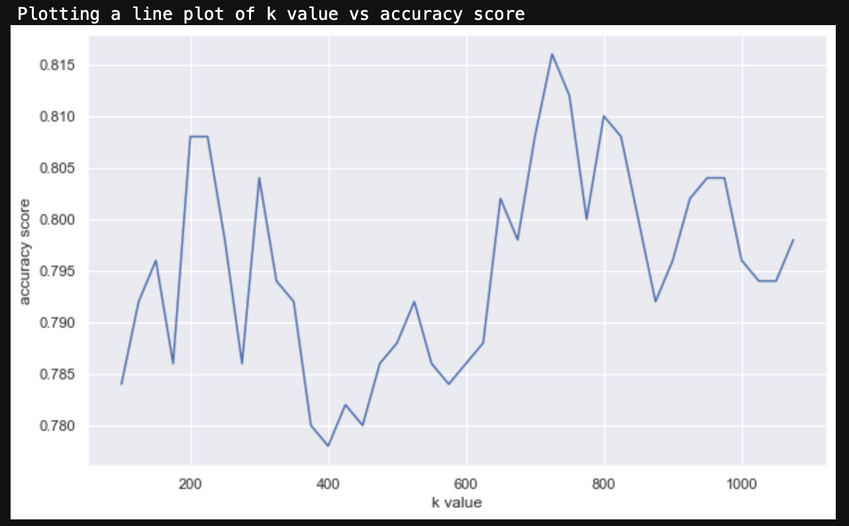
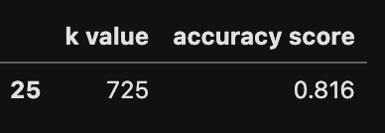
k parameter vs KNeighborsClassifier’s model accuracy
The line plot depicting the relationship between K value and accuracy
Figure: showing the maximum accuracy by a given K value
Key insights:
Maximum accuracy is given when k =725
Figure: Line plot for k value vs accuracy

Slide 24
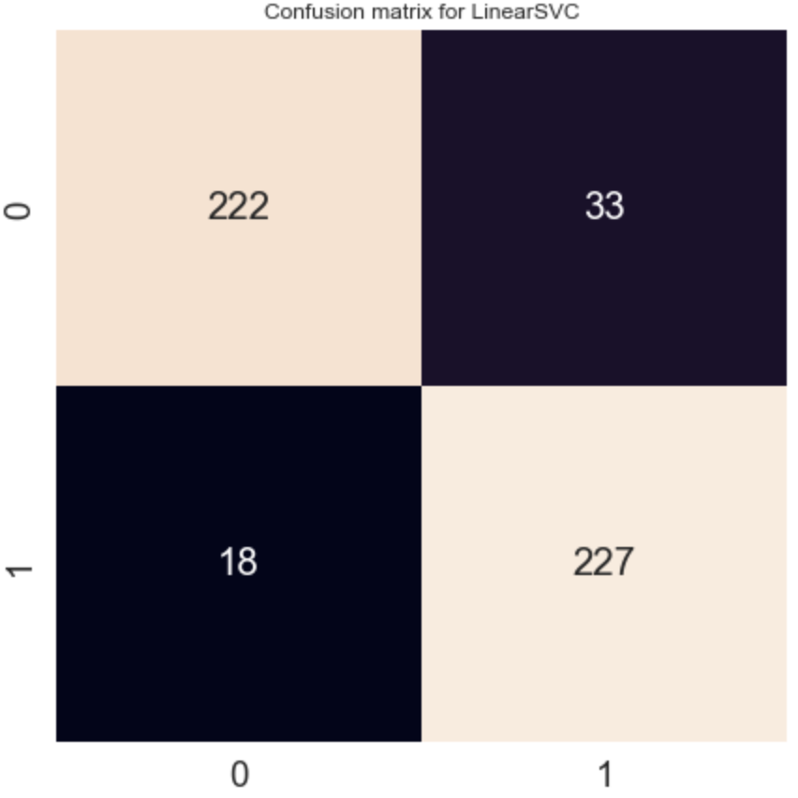
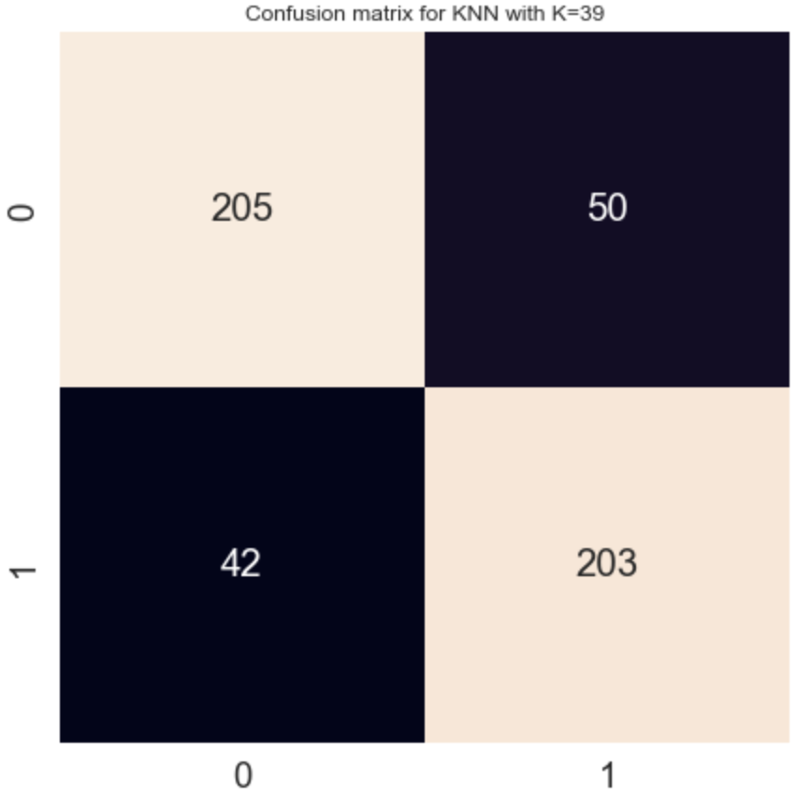


Comparison between LinearSVC and KNeighborsClassifier
Comparison between Confusion Matrix for LinearSVC and KNeighborsClassifier.
Figure: Confusion Matrix and accuracy for LinearSVC
Figure: Confusion Matrix and accuracy for KNeighborsClassifier

Slide 25
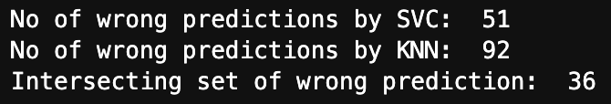
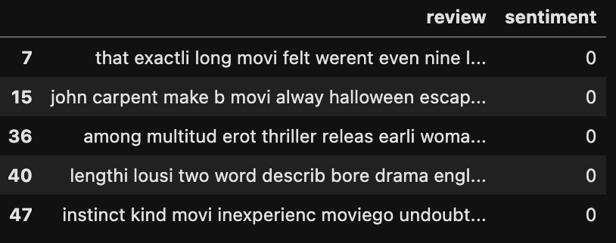
What lead to wrong predictions?
Key insights:
36 records were misclassified by both of the classifiers. Can these be outliers or mislabelled data?
All of the misclassified records have label 0.
Figure: Number of wrong predictions
Figure: Wrong predictions
Notes:
Create functions that calculated the mean and median using pandas mean and median. Grouping by movie id.

Slide 26
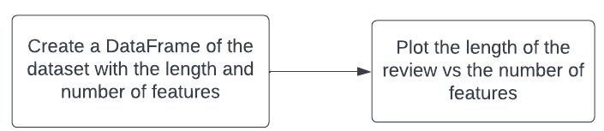
Methodology - Problem 4
Goal: To find a two-dimensional plot in which the positive and negative reviews are separated
Method:Plot the length of the review versus the number of features
Figure: Workflow for Problem 4

Slide 27
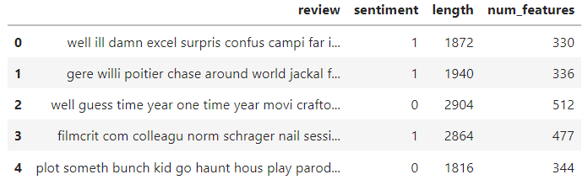
Calculate number of features in each review
Created a function to calculate the number of features in each review then add it to the DataFrame
Figure: DataFrame with the newly added num_features column

Slide 28
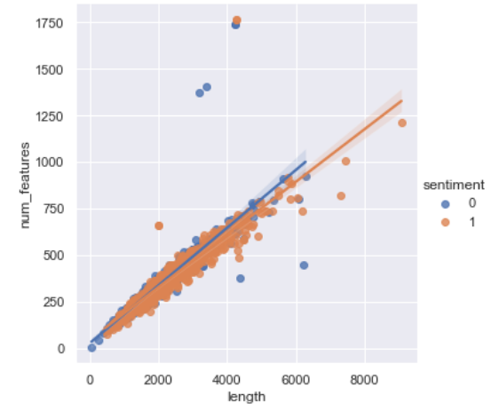
An attempt at separating positive and negative reviews
Key insights:
Failed to separate positive and negative reviews
Most of the positive and negative reviews here overlap each others
Figure: Scatterplot of the reviews length vs the number of features in that review

Slide 29
Conclusions
min_df = 2 for TfIdf works best for our task
max_df = 600 for IfIdf works best for our task
n_gram range =(1,3) for TfIdf is ideal for our case study
LinearSVC with parameter C=9 is ideal for our case study
KNN with k=725 is best for our case study
LinearSVC out performs KNN for our case study

